Slide 1

Version Control Systems
Git and GitHub
Notes:
https://ocw.mit.edu/ans7870/6/6.005/s16/classes/05-version-control/index.html

Slide 2
Introduction
main_ms1
main_ms2
main (HEAD)
Version Control Systems (VCS) are an essential part of the software development process.
Every project should have a VCS
Basics of VCS:
Develop main.cpp
Finish major aspect of lab...save main.cpp as main_milestone1.cpp
Continue developing on main.cpp
Finish major aspect of lab...save main.cpp as main_milestone2.cpp
Continue developing on main.cpp
Something breaks...submit main_milestone2.cpp (Revert)
how do we scale this process?

Slide 3

Multiple developers
main_v1A
main_v1B
main_v1
main_v2A
main_v2B
Two people on a team developing different functions in the same file
Person 1 has developed version 1A and 1B and is still working
Person 2 has developed version 2A and would like to combine their work
How can they merge their work?

Slide 4
Basic VCS functionality
In general, we want a VCS to be able to
Revert to a past version
Compare two different versions
Push full version history to another location
Pull history back from that location
Merge versions that are offshoots of the same earlier version
Branch versions off current versions
Track responsibility of changes in code (who did what)
Work in parallel on different aspects of the code base
Work in progress and share that incomplete work

Slide 5
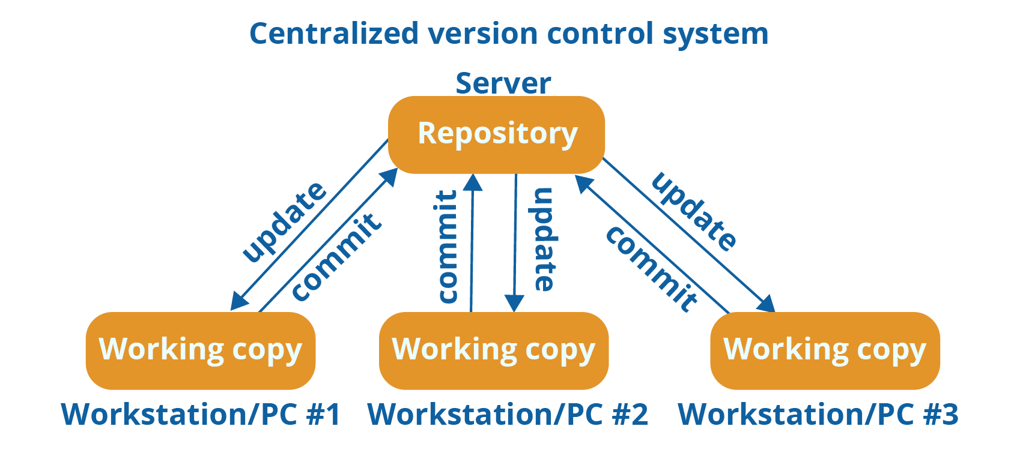
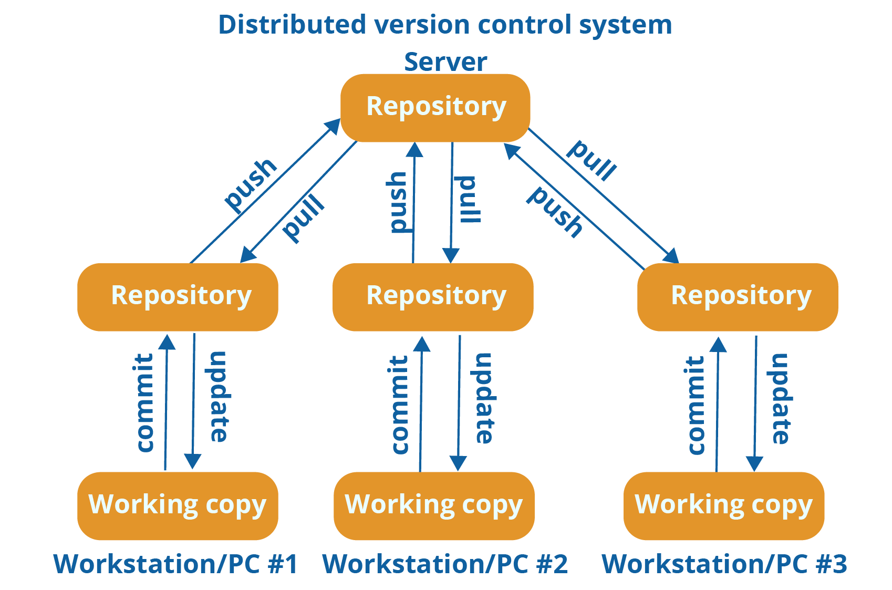
Types of Version Control Systems
Centralized Version Control
Examples: CVS (Concurrent Versions System), SVN (Subversion)
Distributed Version Control
Examples: Git, Mercurial
Notes:
Image Source: https://medium.com/faun/centralized-vs-distributed-version-control-systems-a135091299f0

Slide 6
Git flow - New repository
$ git clone <repository>
Clone the object graph from the remote repository
Automatically does checkout on default branch*
$ git checkout <branch>
Checkout the <branch> from the object file
Gets a working directory full of editable files
Remote (GitHub)
Local
Headers
(.hpp)
checkout
Source
(.cpp)
.git
clone
The term “master” branch is being phased out due references to slavery. Accepted new terms are “main/default/primary”. In this course we will be using “main” though be prepared to find “master” within third party documentation.
Notes:
https://www.zdnet.com/article/github-to-replace-master-with-alternative-term-to-avoid-slavery-references/#:~:text=ZDNet%20Academy-,GitHub%20to%20replace%20%22master%22%20with%20alternative%20term%20to%20avoid%20slavery,its%20CEO%20said%20on%20Friday.

Slide 7
Git flow - new session
$git fetch
See what changes have been made (metadata only)
$git pull
Pull any changes from remote and update working directory
Remote (GitHub)
Local
pull
(1)
Headers
(.hpp)
Pull (2)
Source
(.cpp)
.git
fetch

Slide 8
Git flow - develop locally
Develop….
$git add <file(s)>
$git commit
Update commit message
Local
Working directory
Staging area
Local repo
edit.cpp
#include <iostream>
using namespace std;
int main() {
cout << “Hello GitHub” << endl;
return 0;
}
Headers
(.hpp)
edit.cpp
commit
edit.cpp
[main 2bae255] Initialize main file in repo
1 file changed, 8 insertions(+)
create mode 100644 main.cpp
Source
(.cpp)
add
edit.cpp
New commit added to git object graph

Slide 9
Git flow - Inspect changes
$git show <hash*>
Local
commit <hash> (HEAD -> main)
Author: Jeffrey-laptop <jmcda001@ucr.edu>
Date: Fri Jul 17 11:52:47 2020 -0700
Initialize main file in repo
diff --git a/main.cpp b/main.cpp
new file mode 100644
index 0000000..a7470b8
--- /dev/null
+++ b/main.cpp
@@ -0,0 +1,8 @@
+#include <iostream>
+
+using namespace std;
+
+int main() {
+ cout << "Hello GitHub world!" << endl;
+ return 0;
+}
Working directory
Staging area
Local repo
Headers
(.hpp)
Source
(.cpp)
* hash is the commit ID of the commit you’d like to see.

Slide 10
Git flow - Inspect changes
Commits look like a diff to only show you what has changed
You can see
The whole tree: $git show <hash>:
Just a file at a commit: $git show <hash>:<filename>
commit <hash> (HEAD -> main)
Author: Jeffrey-laptop <jmcda001@ucr.edu>
Date: Fri Jul 17 11:52:47 2020 -0700
Initialize main file in repo
diff --git a/main.cpp b/main.cpp
new file mode 100644
index 0000000..a7470b8
--- /dev/null
+++ b/main.cpp
@@ -0,0 +1,8 @@
+#include <iostream>
+
+using namespace std;
+
+int main() {
+ cout << "Hello GitHub world!" << endl;
+ return 0;
+}

Slide 11
Git flow - end session
$git push
Push changes from local repo to remote
Remote (GitHub)
Local
Headers
(.hpp)
Source
(.cpp)
.git
push

Slide 12
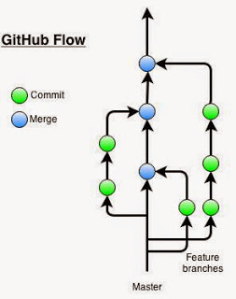
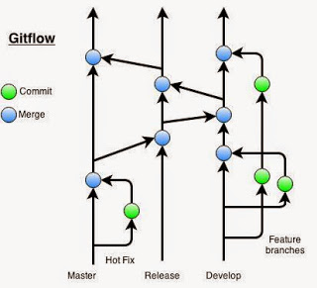
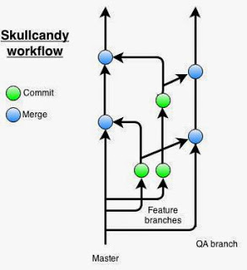
Examples of Git Workflows
Notes:
https://www.endpoint.com/blog/2014/05/02/git-workflows-that-work

Slide 13
The GitHub Flow

Slide 14
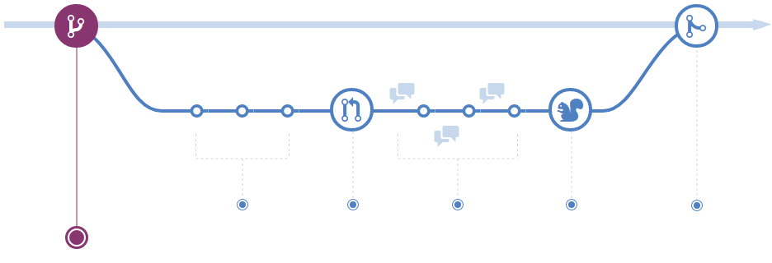
Feature branching - branch
main is always deployable
New features branch off main ($git checkout -b <branch-name>)
Naming: <GitHub-handle>/<short-feature-description>
Notes:
https://guides.github.com/introduction/flow/

Slide 15
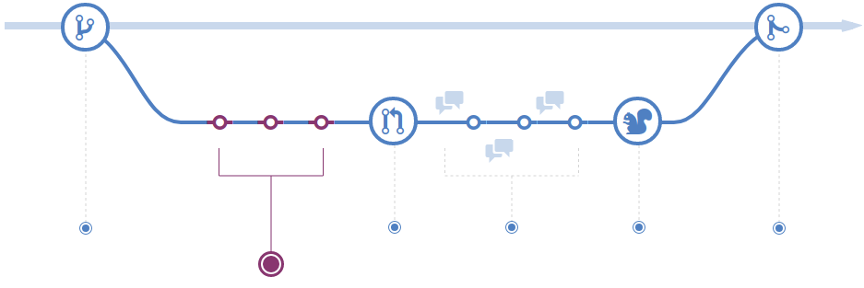
Feature branching - Committing
Work on the feature making commits ($git commit)
Write clear and concise commit messages
Notes:
https://guides.github.com/introduction/flow/

Slide 16
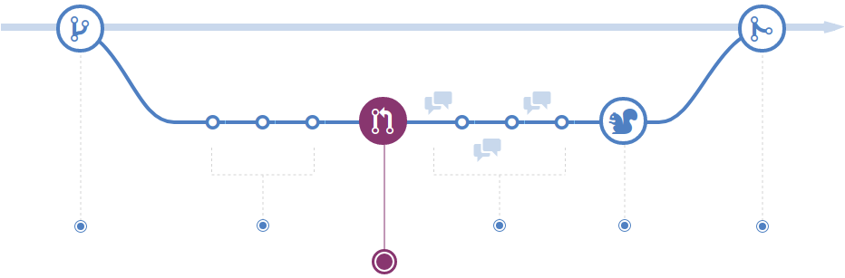
Feature branching - Pull request (PR)
Pull Requests (PRs) initiate a discussion about your commits
Make sure changes are correct and everyone understands them
Notes:
https://guides.github.com/introduction/flow/

Slide 17
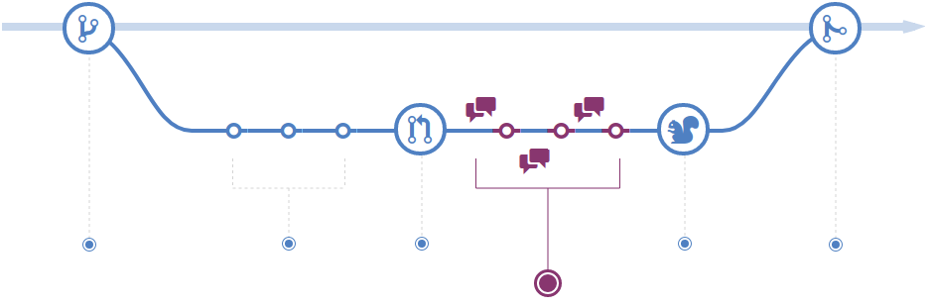
Feature branching - Discussion (Team)
People on the team review your code, provide questions/comments
Issues may be introduced for new features or bug-fixes
Contribute to the discussion and fixed/close new issues (“Closes #<x>”)
Notes:
https://guides.github.com/introduction/flow/

Slide 18
Code Reviews
Review fewer than 400 lines of code at a time
Take your time. Inspection rates should be under 500 LoC/hour
Do not review for more than 60 minutes at a time
Set goals and capture metrics
Authors should annotate source code before the review
Use checklists
Establish a process for fixing defects found
Foster a positive code review culture
Embrace the subconscious implications of peer review
Practice lightweight code reviews
Notes:
https://smartbear.com/learn/code-review/best-practices-for-peer-code-review/

Slide 19
Stay positive
Start with a positive note
Reference the code not the coder
Use line item suggestions (make comments on specific lines)
Don’t assume you know better. Rather than saying something is wrong
Ask for clarification,
Ask for more context, or
suggest an alternative method and ask the coder what their thoughts are
Notes:
https://smartbear.com/learn/code-review/best-practices-for-peer-code-review/

Slide 20
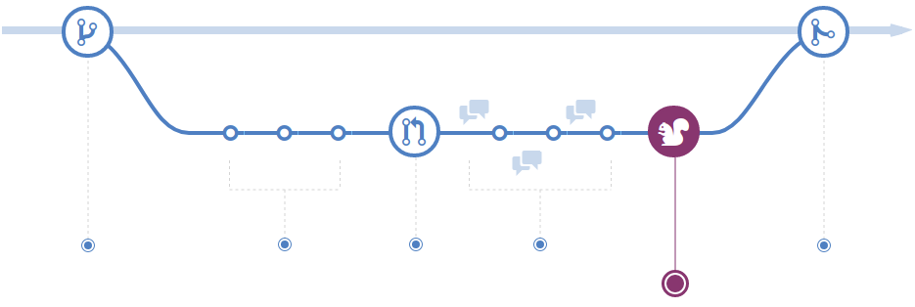
Feature branching - Deploy
Once your PR passes the code review and testing* deploy and verify in production
Notes:
https://guides.github.com/introduction/flow/

Slide 21
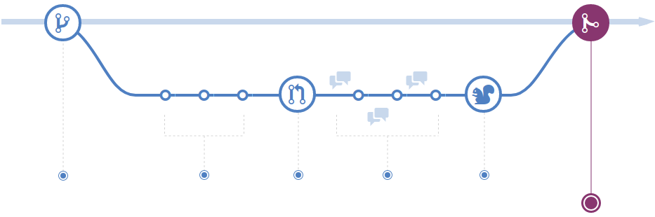
Feature branching - Merge
With everything verified, merge into main
Notes:
https://guides.github.com/introduction/flow/

Slide 22
Tagging
Tags indicate that a commit is special. Typically indicating a stable version
$git tag -a <tag-name> [<hash>] -m “<description>” $git push origin <tag-name>
-a: Add the name of the tag
-m: Same as commit, inline create the message (discouraged)
[<hash>]: Optionally tag a commit other than the current commit
git tag will only tag locally so don’t forget to push!

Slide 23
Versioning
There are many different schemes for versioning, but they are all somewhat similar
4.2.1 Major.Minor.patch
Major - Breaking changes (high risk)
Minor - Non-breaking features (medium risk)
patch - Non-breaking changes (lowest risk)

Slide 24
Versioning
0.x in open source communities indicates work-in-progress, 1.0 indicates that the software is “complete”
MAME emulator never intend to release a 1.0 since there will always be more games it will never be “complete”. Version 0.99 followed by 0.100
SUSE Linux started with version 4.2 in reference to “The Hitchhiker’s Guide to the Galaxy”
Slackware Linux was versioned 13.37
Many distributions skip versions for a variety of marketing reasons

Slide 25
Reverting
X
An “undo” type operation. Inverts changes and makes new commit with inverse content
$git revert <ref>
$git revert HEAD (common usage)
--no-commit: This option adds inverse changes to Staging Index and Working Directory but does not commit

Slide 26
Changing the default branch
Rename your local branch $git branch -m master main
Push renamed branch upstream and set remote tracking branch. $git push -u origin main
Log into the upstream repository host (GitHub) and change the “default branch” Settings->Branches->Default branch
Delete the old branch upstream. $git push origin --delete master
Update the upstream remote’s HEAD. $git remote set-head origin -a
Notes:
https://dev.to/rhymu8354/git-renaming-the-master-branch-137b

Slide 27
Everyone else
Fetch the latest branches from the remote $git fetch --all
Update the upstream remote’s HEAD $git remote set-head origin -a
Switch your local branch to track the new remote branch $git branch --set-upstream-to origin/main
Rename your branch locally $git branch -m master main

Slide 28
Learn more:
Practice: https://learngitbranching.js.org/
Git Cheat Sheet: https://education.github.com/git-cheat-sheet-education.pdf

Slide 29
Terminology
Repository - A local or remote store of the versions of a project
Working copy - A local, editable copy of a project
File - A single file in a project
Version (revision) - A record of the contents of a project at a give time
Change (diff) - The difference between two versions
Head - The current version
Branch - A version of the repository that diverges from the main
Checkout - Switch between branches
Clone - Copy of (or action of copying) a repository
Index - The working, or staging, area of Git
Main (master) - Primary branch of the repository

Slide 30
Terminology
Merge - Taking changes from one branch and adding them into another
Origin - Conventional name for primary version of a repository
Pull Request (PR) - Ask repo maintainers to review commits and discuss, or accept, them
Push - Update a remote branch with the commits made to the current branch
Stash - “Stash” changes to work on other changes in the working area
Tag - Define which portions of Git history is most important
Upstream - Where you push your changes to (often on origin)

